Slide 1
Target Range

Slide 2
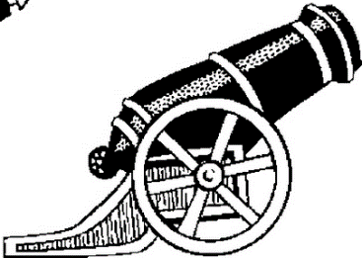





Target Range
A cannon ball is fired and passes through the two points shown.
What is the range of the cannon ball?
$$g=10 ms^{−2}$$
$$\left(260, 192.4\right)$$
$$×$$
$$×$$
$$\left(850, 127.5\right)$$
(not to scale: all distances in metres)
What’s the angle of projection?
What’s the initial velocity?

Slide 3

Target Range
A cannon ball is fired and passes through the two points shown.
What is the range of the cannon ball?
$$g=10 ms^{−2}$$
$$\left(260, 192.4\right)$$
$$×$$
$$×$$
$$\left(850, 127.5\right)$$
(not to scale: all distances in metres)
What’s the angle of projection?
What’s the initial velocity?

Slide 4
Target Range
A cannon ball is fired and passes through the two points shown.
What is the range of the cannon ball?
$$g=10 ms^{−2}$$
$$\left(260, 192.4\right)$$
$$×$$
$$×$$
$$\left(850, 127.5\right)$$
(not to scale: all distances in metres)
What’s the angle of projection?
What’s the initial velocity?

Slide 5
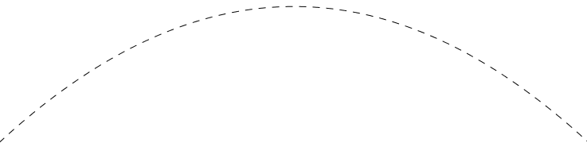
Target Range
A cannon ball is fired and passes through the two points shown.
What is the range of the cannon ball?
$$g=10 ms^{−2}$$
$$\left(260, 192.4\right)$$
$$×$$
$$×$$
$$\left(850, 127.5\right)$$
(not to scale: all distances in metres)
What’s the angle of projection?
What’s the initial velocity?

Slide 6
Target Range
The trajectory is a parabola so you can fit one to the data.
$$g=10 ms^{−2}$$
$$\left(260, 192.4\right)$$
$$×$$
$$×$$
$$\left(850, 127.5\right)$$
(not to scale: all distances in metres)

Slide 7


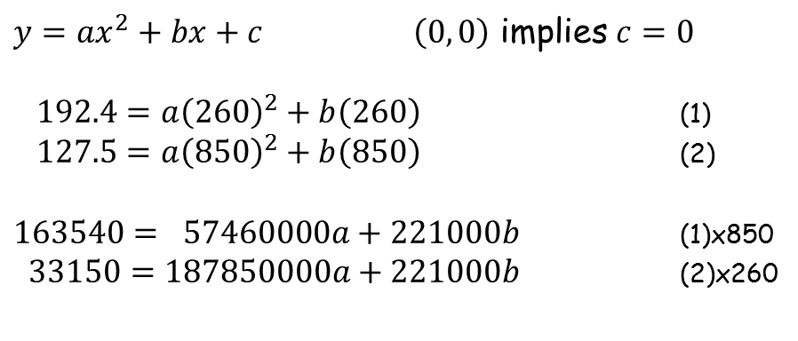
Target Range
The trajectory is a parabola so you can fit one to it.
$$y$$
$$\left(260, 192.4\right)$$
$$×$$
$$×$$
$$\left(850, 127.5\right)$$
$$x$$
$y=ax^{2}+bx+c$ $\left(0, 0\right)$ implies $c=0$
$192.4=a{\left(260\right)}^{2}+b\left(260\right)$ (1)
$127.5=a{\left(850\right)}^{2}+b\left(850\right)$ (2)
$163540= 57460000a+221000b$ (1)x850
$33150=187850000a+221000b$ (2)x260

Slide 8
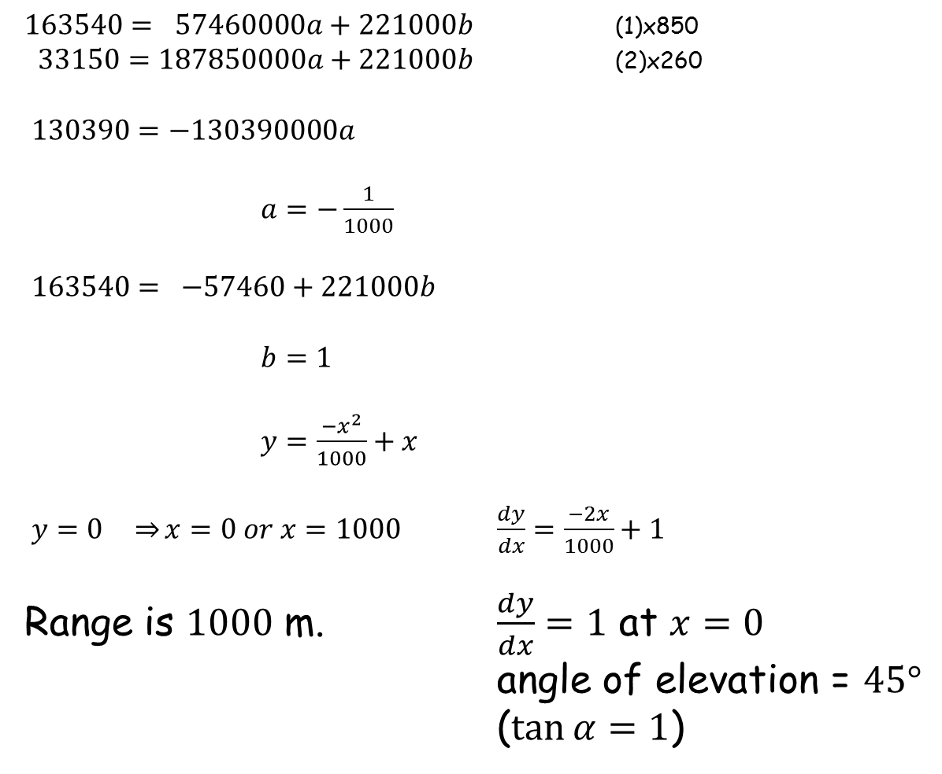
Target Range
$163540= 57460000a+221000b$ (1)x850
$33150=187850000a+221000b$ (2)x260
$130390=−130390000a$
$a=−\frac{1}{1000}$
$163540= −57460+221000b$
$b=1$
$y=\frac{−x^{2}}{1000}+x$
$y=0 \underset{⇒}{}x=0 or x=1000$ $\frac{dy}{dx}=\frac{−2x}{1000}+1$
Range is $1000$ m. $\frac{dy}{dx}=1$ at $x=0$
angle of elevation = $45°$
($\tan{α=1}$)

Slide 9
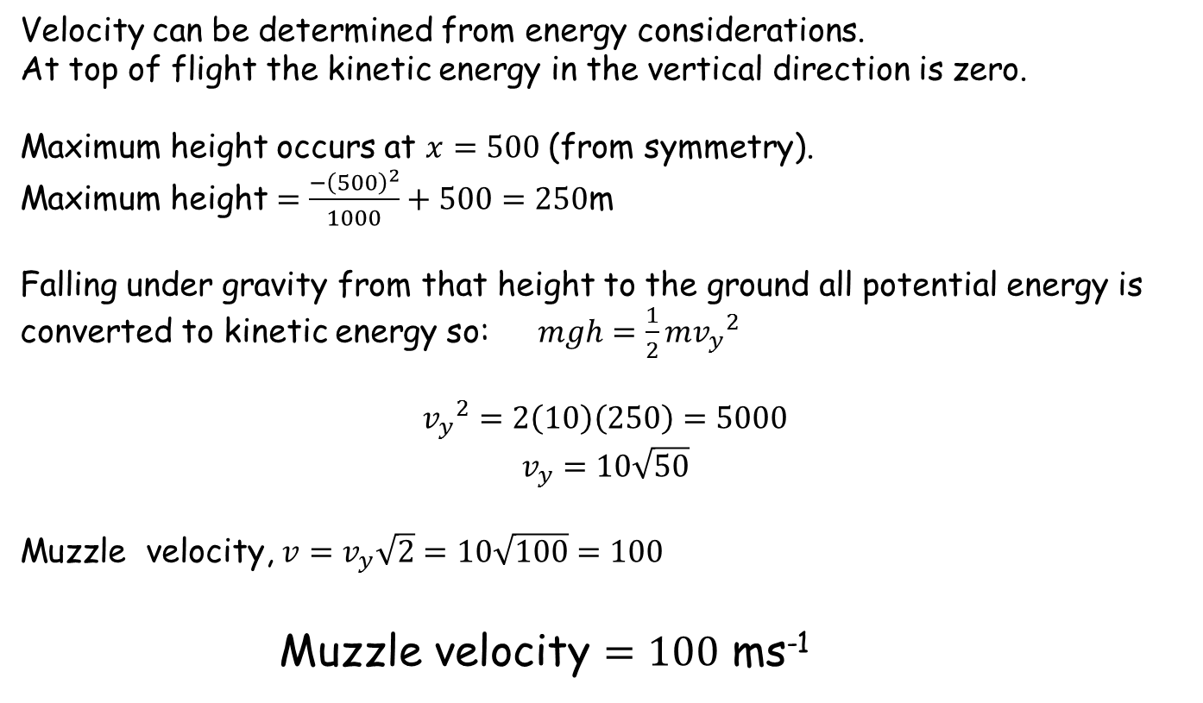
Target Range
Velocity can be determined from energy considerations.
At top of flight the kinetic energy in the vertical direction is zero.
Maximum height occurs at $x=500$ (from symmetry).
Maximum height $=\frac{−{\left(500\right)}^{2}}{1000}+500=250$m
Falling under gravity from that height to the ground all potential energy is converted to kinetic energy so: $mgh=\frac{1}{2}m{v_{y}}^{2}$
$${v_{y}}^{2}=2\left(10\right)\left(250\right)=5000$$
$$v_{y}=10\sqrt{50}$$
Muzzle velocity, $v=v_{y}\sqrt{2}=10\sqrt{100}=100$
Muzzle velocity $=100$ ms⁻¹

Slide 10
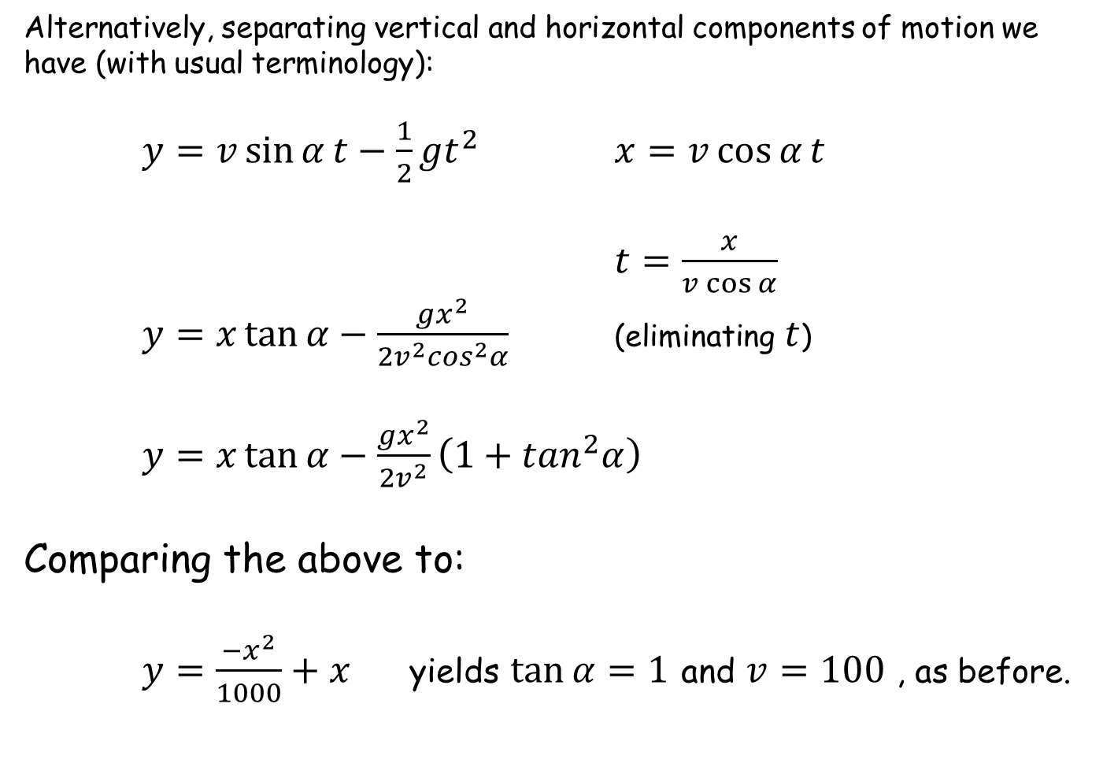
Target Range
Alternatively, separating vertical and horizontal components of motion we have (with usual terminology):
$y=v\sin{α}t−\frac{1}{2}gt^{2}$ $x=v\cos{α}t$
$t=\frac{x}{v\cos{α}}$
$y=x\tan{α}−\frac{gx^{2}}{2v^{2}\cos^{2}α}$ (eliminating $t$)
$y=x\tan{α−\frac{gx^{2}}{2v^{2}}\left(1+\tan^{2}α\right)}$
Comparing the above to:
$y=\frac{−x^{2}}{1000}+x$ yields $\tan{α}=1$ and $v=100$ , as before.

Slide 12
Note to Teacher
There is a sound effect on slide 3.
All parabolas are the same so all the answers are the same
Each worksheet just has different coordinates

Slide 13
RESOURCES

Slide 14


Target Range
A cannon ball is fired and passes through the two points shown.
What is the range of the cannon ball?
$$g=10 ms^{−2}$$
$$(180, 147.6)$$
$$×$$
$$×$$
$$(870, 113.1)$$
(not to scale: all distances in metres)
What’s the angle of projection?
What’s the muzzle velocity?
A
SIC_33

Slide 15


Target Range
A cannon ball is fired and passes through the two points shown.
What is the range of the cannon ball?
$$g=10 ms^{−2}$$
$$(210, 165.9)$$
$$×$$
$$×$$
$$(890, 97.9)$$
(not to scale: all distances in metres)
What’s the angle of projection?
What’s the muzzle velocity?
B
SIC_33

Slide 16


Target Range
A cannon ball is fired and passes through the two points shown.
What is the range of the cannon ball?
$$g=10 ms^{−2}$$
$$(220, 171.6)$$
$$×$$
$$×$$
$$(860, 120.4)$$
(not to scale: all distances in metres)
What’s the angle of projection?
What’s the muzzle velocity?
C
SIC_33

Slide 17


Target Range
A cannon ball is fired and passes through the two points shown.
What is the range of the cannon ball?
$$g=10 ms^{−2}$$
$$(230, 177.1)$$
$$×$$
$$×$$
$$(910, 81.9)$$
(not to scale: all distances in metres)
What’s the angle of projection?
What’s the muzzle velocity?
D
SIC_33

Slide 18


Target Range
A cannon ball is fired and passes through the two points shown.
What is the range of the cannon ball?
$$g=10 ms^{−2}$$
$$(240, 182.4)$$
$$×$$
$$×$$
$$(840, 134.4)$$
(not to scale: all distances in metres)
What’s the angle of projection?
What’s the muzzle velocity?
E
SIC_33

Slide 19


Target Range
A cannon ball is fired and passes through the two points shown.
What is the range of the cannon ball?
$$g=10 ms^{−2}$$
$$(250, 187.5)$$
$$×$$
$$×$$
$$(830, 141.1)$$
(not to scale: all distances in metres)
What’s the angle of projection?
What’s the muzzle velocity?
F
SIC_33

Slide 20


Target Range
A cannon ball is fired and passes through the two points shown.
What is the range of the cannon ball?
$$g=10 ms^{−2}$$
$$(280, 201.6)$$
$$×$$
$$×$$
$$(820, 147.6)$$
(not to scale: all distances in metres)
What’s the angle of projection?
What’s the muzzle velocity?
G
SIC_33

Slide 21


Target Range
A cannon ball is fired and passes through the two points shown.
What is the range of the cannon ball?
$$g=10 ms^{−2}$$
$$(270, 197.1)$$
$$×$$
$$×$$
$$(810, 153.9)$$
(not to scale: all distances in metres)
What’s the angle of projection?
What’s the muzzle velocity?
H
SIC_33

Slide 22


Target Range
A cannon ball is fired and passes through the two points shown.
What is the range of the cannon ball?
$$g=10 ms^{−2}$$
$$(290, 205.9)$$
$$×$$
$$×$$
$$(790, 165.9)$$
(not to scale: all distances in metres)
What’s the angle of projection?
What’s the muzzle velocity?
I
SIC_33

Slide 23


Target Range
A cannon ball is fired and passes through the two points shown.
What is the range of the cannon ball?
$$g=10 ms^{−2}$$
$$(310, 213.9)$$
$$×$$
$$×$$
$$(770, 177.1)$$
(not to scale: all distances in metres)
What’s the angle of projection?
What’s the muzzle velocity?
J
SIC_33

Slide 24


Target Range
A cannon ball is fired and passes through the two points shown.
What is the range of the cannon ball?
$$g=10 ms^{−2}$$
$$(320, 217.6)$$
$$×$$
$$×$$
$$(760, 182.4)$$
(not to scale: all distances in metres)
What’s the angle of projection?
What’s the muzzle velocity?
K
SIC_33

Slide 25


Target Range
A cannon ball is fired and passes through the two points shown.
What is the range of the cannon ball?
$$g=10 ms^{−2}$$
$$(330, 221.1)$$
$$×$$
$$×$$
$$(750, 187.5)$$
(not to scale: all distances in metres)
What’s the angle of projection?
What’s the muzzle velocity?
L
SIC_33

Slide 26


Target Range
A cannon ball is fired and passes through the two points shown.
What is the range of the cannon ball?
$$g=10 ms^{−2}$$
$$(340, 224.4)$$
$$×$$
$$×$$
$$(740, 192.4)$$
(not to scale: all distances in metres)
What’s the angle of projection?
What’s the muzzle velocity?
M
SIC_33

Slide 27


Target Range
A cannon ball is fired and passes through the two points shown.
What is the range of the cannon ball?
$$g=10 ms^{−2}$$
$$(350, 227.5)$$
$$×$$
$$×$$
$$(730, 197.1)$$
(not to scale: all distances in metres)
What’s the angle of projection?
What’s the muzzle velocity?
N
SIC_33

Slide 28


Target Range
A cannon ball is fired and passes through the two points shown.
What is the range of the cannon ball?
$$g=10 ms^{−2}$$
$$(360, 230.4)$$
$$×$$
$$×$$
$$(720, 201.6)$$
(not to scale: all distances in metres)
What’s the angle of projection?
What’s the muzzle velocity?
O
SIC_33

Slide 29


Target Range
A cannon ball is fired and passes through the two points shown.
What is the range of the cannon ball?
$$g=10 ms^{−2}$$
$$(370, 233.1)$$
$$×$$
$$×$$
$$(710, 205.9)$$
(not to scale: all distances in metres)
What’s the angle of projection?
What’s the muzzle velocity?
P
SIC_33

